Slide 1


          University of Diyala
          College of Engineering
          Department of Electronics Engineering
Course Number: U103
Course Name: Computer Networks
Lecture (8)
Asst. Lect. Ahmed Mohammed Ahmed

Slide 2
Networking Devices
Common Network Connectivity Devices: - Because these devices connect network entities, they’re known as connectivity devices. Here’s a list of the devices.
Hub
Repeater
Modem
Network Interface Card (NIC)
Bridge
Basic Switch
Wireless access point (AP)
Basic router
Basic firewall
Basic Dynamic Host Configuration Protocol

Slide 3
Hub:-
A hub is the device that connects all the segments of the network together in a star topology Ethernet network. Every device in the network connects directly to the hub through a single cable and is used to connect multiple devices without segmenting a network. Any transmission received on one port will be sent out all the other ports in the hub, including the receiving pair for the transmitting device, so that Carrier Sense Multiple Access with Collision Detection (CSMA/CD) on the transmitter can monitor for collisions.

Slide 4
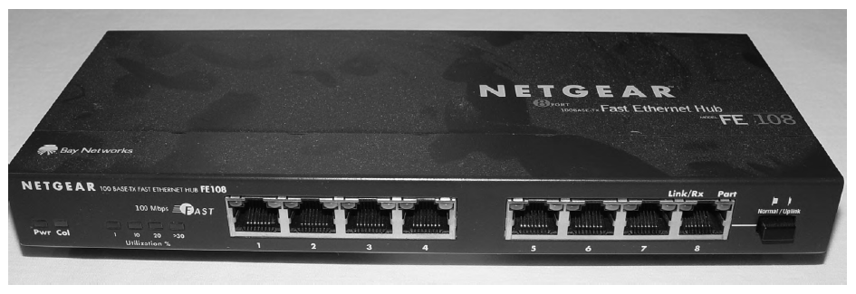

Slide 5
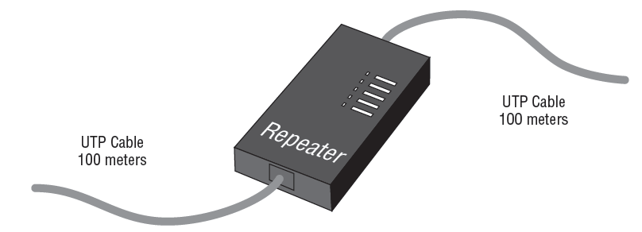
Repeater:-
Figure below shows a repeater being used to connect two unshielded twisted-pair (UTP) connectors. This configuration will provide an extension to your Ethernet segment and give you a gain of another 100 meters (328 feet).

Slide 6
Modem: - A modem is a device that modulates digital data onto an analog carrier for transmission over an analog medium and then demodulates from the analog carrier to a digital signal again at the receiving end. The term modem is actually an acronym that stands for MOdulator/DEModulator.
When you hear the term modem, three different types should come to mind:
Traditional (plain old telephone service [POTS])
DSL
Cable

Slide 7
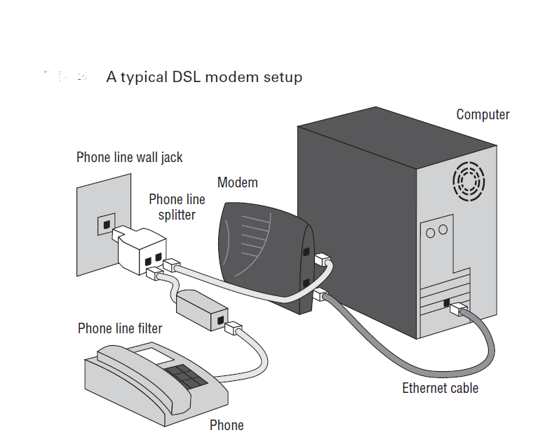

Slide 8
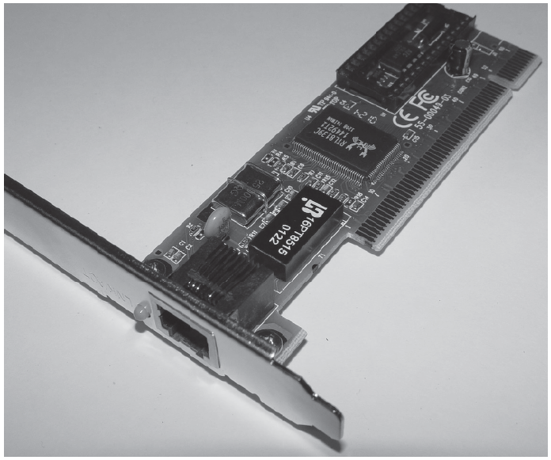
Network Interface Card (NIC):- A network Interface Card (NIC) is installed in computer to connect, or interface, computer to the network. It provides the physical, electrical, and electronic connections to the network media. Figure below shows a typical 100Mbps Ethernet NIC.

Slide 9
Bridge: - A bridge—specifically, a transparent bridge—is a network device that connects two similar network segments together. Its primary function is to keep traffic separated on either side of the bridge, breaking up collision domains, as pictured in Figure below.

Slide 10
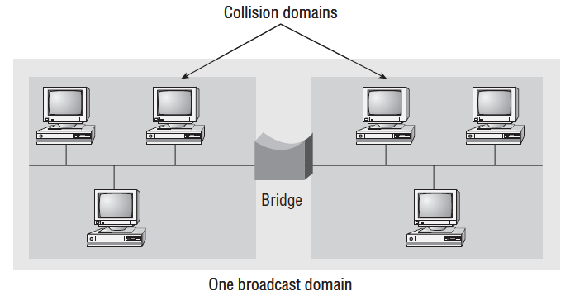

Slide 11
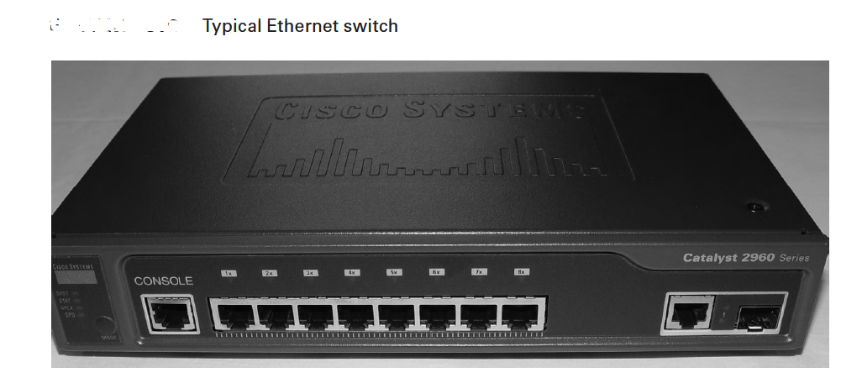
Switches: - Switches connect multiple segments of a network together much like hubs do, but with three significant differences—a switch recognizes frames and pays attention to the source and destination MAC address of the incoming frame as well as the port on which it was received.

